Slide 1
Serial Input/Output Interface

Slide 2
TOPICS
Serial port
Serial port Driver
DUART

Slide 3
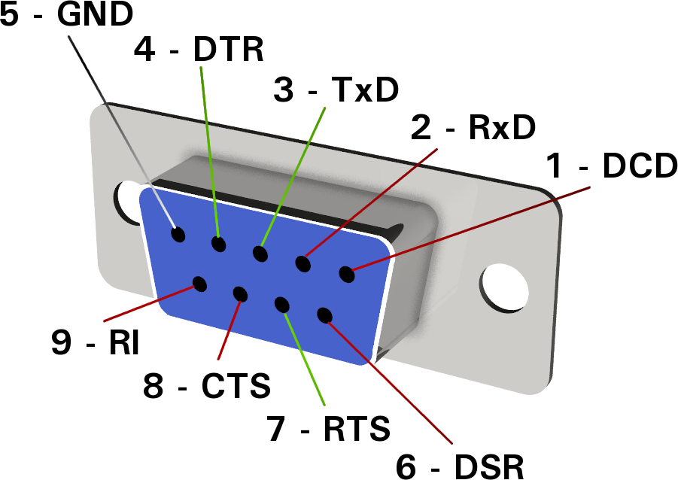
Serial Port (RS232c)
Provides the physical interface between the microcomputer and the terminal PC. The serial port connects to the DUART.

Slide 4


Serial Port
Purpose
  Hardware connection to read and write serial data
Options
  25 pin
  9 pin

Slide 5
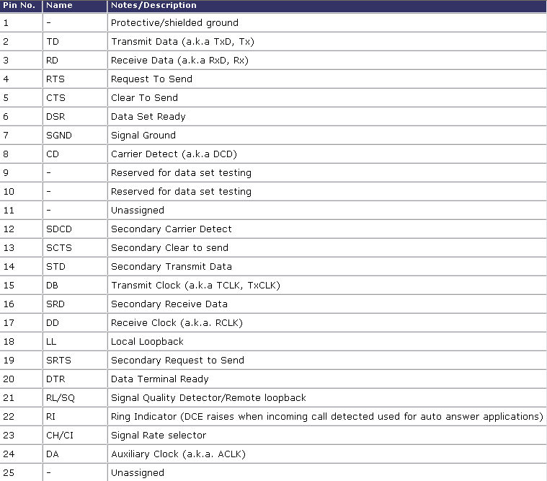
Serial Port (25 pin)

Slide 6
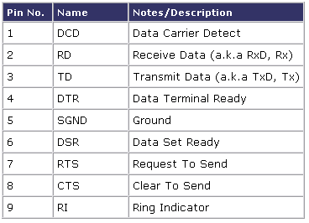
Serial Port (9 pin)

Slide 7
Serial Port (recommended)
9 pin is recommended
  Adequate for given purposes
  25 pin provides many unnecessary options

Slide 8
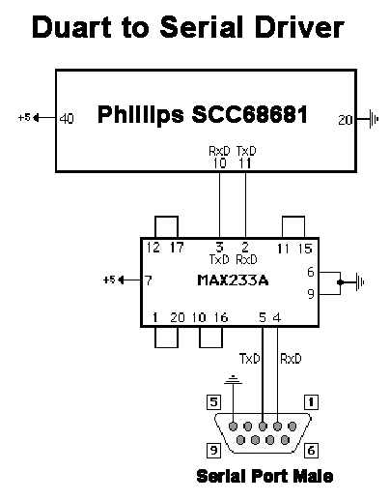
Chip Layout (better picture)

Slide 9
RS-232C
RS232C (Recommended Standard 232 version C) was published in 1969
Originally designed for DTE to DCE (computer to modem) communications
Now being used for DTE to DTE (computer to computer) communications
Most pins are used as control lines.
Control lines negotiate speeds and ready states.

Slide 10
RS-232C Control Lines
Request to Send (RTS), Pin 4
When asserted indicates that the DTE is ready to transmit primary data
Clear To Send (CTS), Pin 5
When asserted indicates that the DCE is ready to transmit primary data
Data Terminal Ready (DTR), Pin 20
When asserted indicates that the data terminal is ready
Data Set Read (DSR), Pin 6
When asserted indicates that the DCE is not in a test, voice, or dial mode, that all initial handshake, answer tone, and timing delay have expired.
Data Carrier Detect (DCD), Pin 8
When asserted indicates that carrier signals are being received from the remote equipment.
Transmit Data (TD), Pin 2
Serial data generated by the DTE
Receive Data (RD), Pin 3
Serial data generated by the DCE

Slide 11
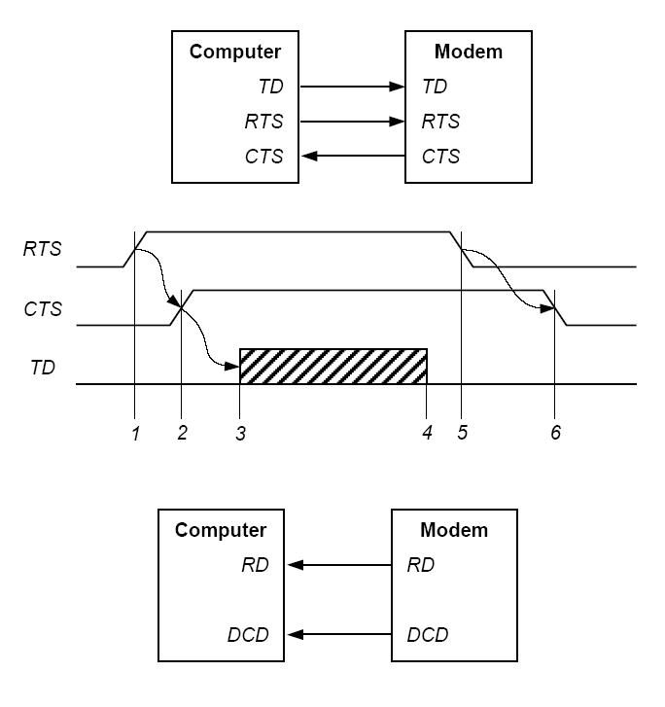
RS-232C
TD – Transmit Data
RTS – Request-to-Send
CTS – Clear-to-Send

Slide 12
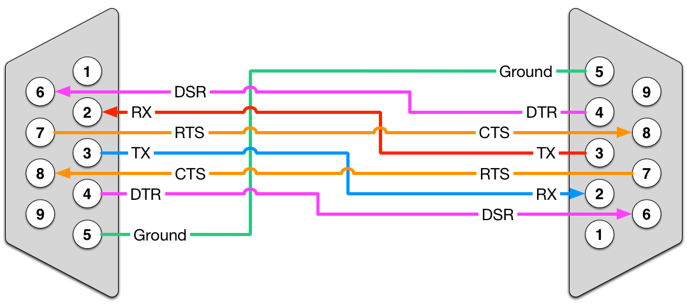
Null Modem
Solution for DTE-DTE (networking)
Control Lines have to be crossed

Slide 13
RS-422
Modernization of RS-232C
Supports multipoint connections
Higher data rates
Greater immunity to noise
A balanced transmission path
The output is balanced with respect to the local ground; that is, the information content of the signal is not dependent on the potential difference between the transmission path and the ground
A pair of wires is used to carry each signal.
The data is encoded and decoded as a differential voltage between the two lines.

Slide 14
Bus Control
Purpose
  Send/receive data between modules
3 components
  Address bus
  Control bus
  Data bus

Slide 15
Buffering
Purpose
  A holding of data when multiple modules are attempting to access the processor
We don’t need it
  Only using RAM, ROM, and Serial I/O

Slide 16
Serial Driver
Purpose
  Process input/output from serial I/O port hardware
Options
  Classic interface chip
  DS1488 (transmitter) & DS1489 (Receiver)
  MAXIM 232
  Maxim 233A

Slide 17
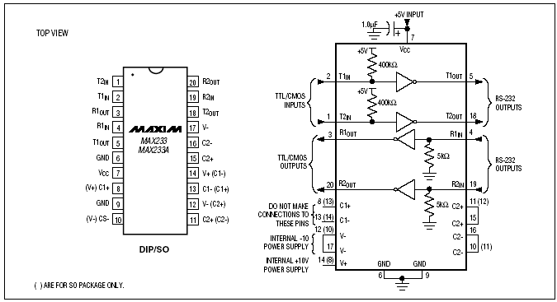
Serial Driver (recommended)
MAX 233A
  Digi-Key part # MAX233ACPP-ND

Slide 18
Part #’s
Serial Driver
  Free sample website
  http://www.maxim-ic.com/quick_view2.cfm/qv_pk/1798
Serial Port connectors
  Mouser, Digi-Key, Jameco
  type in “D-Sub Connectors”

Slide 19
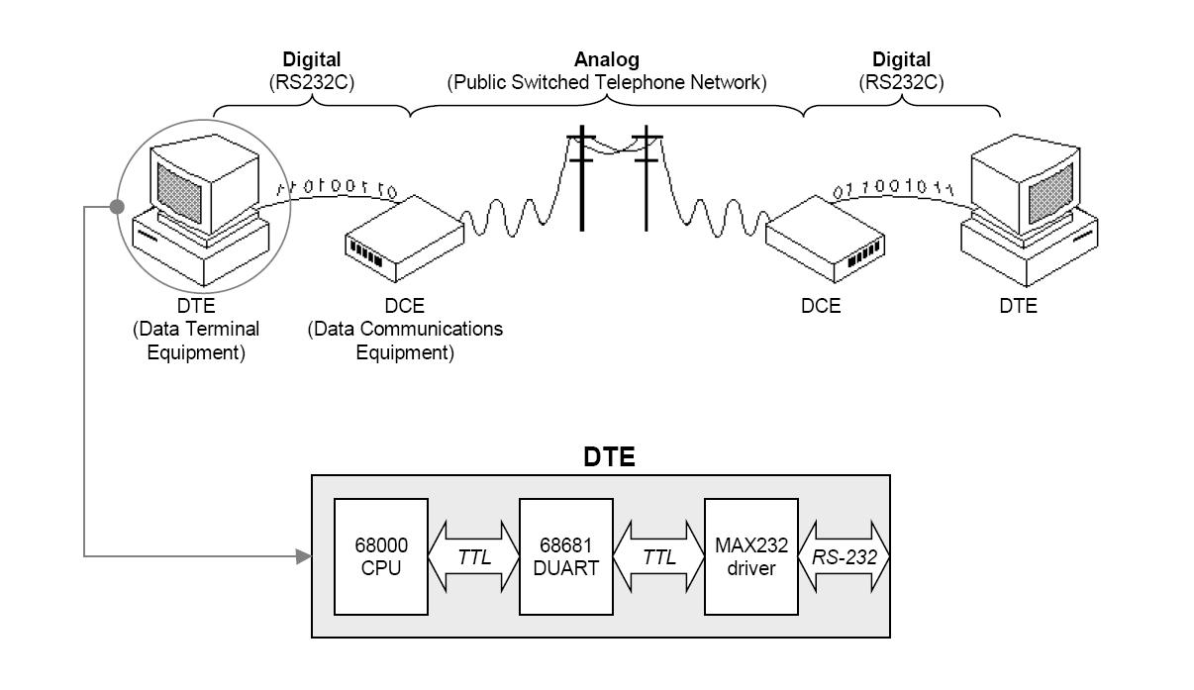
Serial Communications

Slide 20
DUART: Overview
A “universal asynchronous receiver/ transmitter” is a type of "asynchronous receiver/transmitter", a piece of computer hardware that translates data between parallel and serial forms.
The device changes incoming parallel information (within the microcontroller/PC) to serial data which can be sent on a communication line.
Can receive and transmit data to and from a terminal.

Slide 21
DUART: Outline
History
  MC6850
Phillips SCC68681
TI TL16C552
Comparison

Slide 22
DUART: History
PCI - "Programmable Communication Interface"
SCI - "Serial Communications Interface"
ACIA - "Asynchronous Communications Interface Adapter”
All of these are older types of UART

Slide 23
Motorola MC6850 ACIA
ACIA - Asynchronous Communications Interface Adapter
Simply: ACIA allows a computer to communicate with the outside world
Technically: Asynchronous Communications Interface Adapter interconnects external RS-232-compliant peripherals with a microcomputer bus system

Slide 24
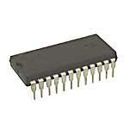
Motorola MC6850 ACIA
Prices and Availability
  Not applicable – ACIA
  is outdated and obsolete

Slide 25
Motorola MC68681 DUART
(Note: MC68681 is no longer available. SCC68681 is a replacement.)
DUART - Dual Universal Asynchronous Receiver/Transmitter
Provides two transmit/receive channels
Can drive two serial ports and one parallel port
Programmable transfer rates
Interfaces well with the 68000 CPU

Slide 26
Motorola MC68681 DUART
The MC68681 has 5 operating modes:
  Normal (full-duplex)
  Automatic-echo
  Local-loopback
  Remote-loopback
  Multidrop mode

Slide 27
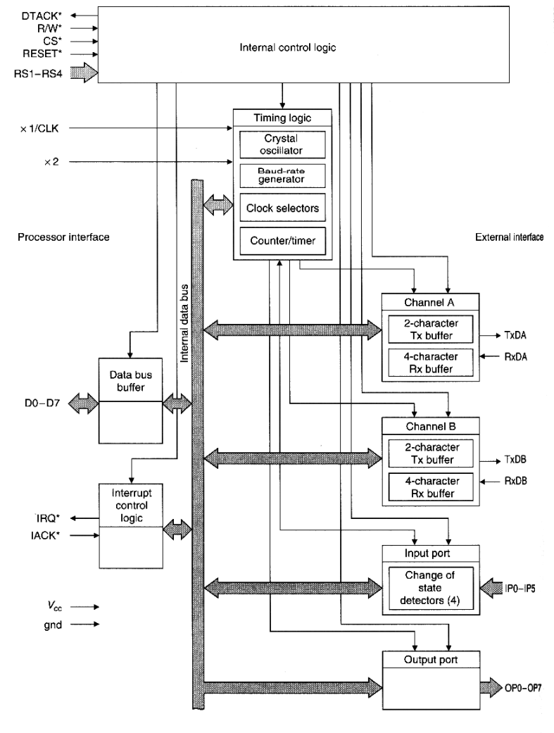
Motorola MC68681 DUART
Connected like SRAM.
  DTACK*
  R/W*
  CS*
  RESET*
  RS1-RS4 (A1-A4)
  D0-D7
  IRQ*
  IACK*

Slide 28
Motorola MC68681 DUART
CSR (Clock Select Register) – sets the serial ports’ baud rates
MR1 (Mode Register 1) – sets serial port options
  Parity mode
  IRQ mode
  Bits-per-character
CR (Command Register) – issues commands
ACR (Auxiliary Control Register) – controls clock source
MR2 (Mode Register 2) – sets mode and stop bit lengths

Slide 29
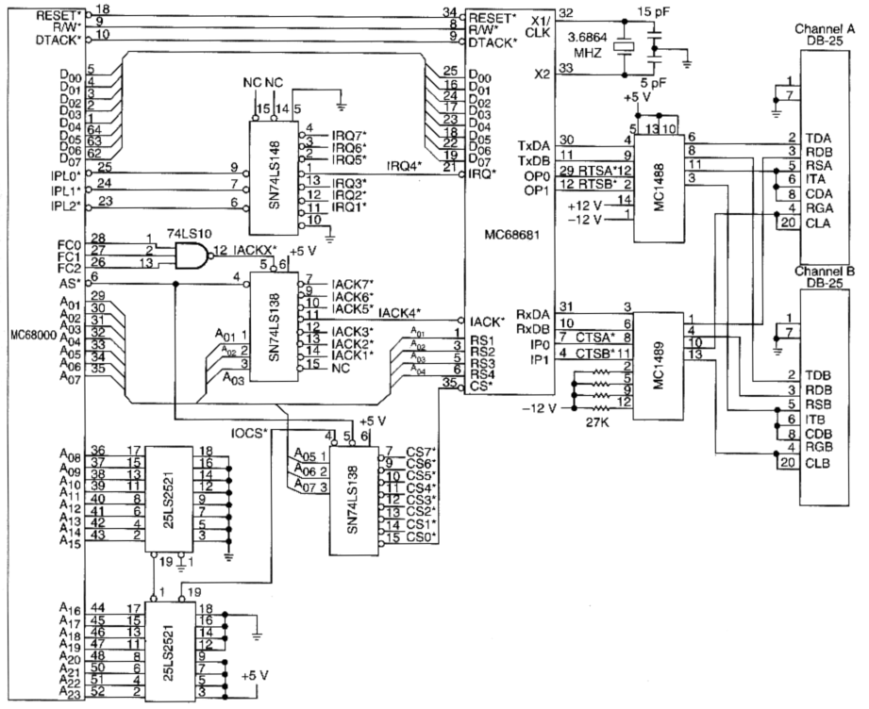
68681 Processor Interface
Textbook p. 737

Slide 30
TI TL16C552 DUART
More versatile than MC68681
Relatively similar interfacing
Free samples available at: www.ti.com
68-pin PLCC package

Slide 31
TI TL16C552 DUART
Pricing information:
  Jameco: $10.49
  Digikey: $10.34
  Sierra IC: Call

Slide 32
Phillips SCC68681 DUART
Works the same as the MC68681
Better interfacing with 68000 MPU (DTACK*, R/W*, IACK*)
40-pin DIP package
Lacks parallel port support

Slide 33
Phillips SCC68681 DUART
Pricing information:
  Ebay: Pricing varies

Slide 34
Practical Matters
There is a DUART from Texas Instruments which surpasses the feature set of the 68681.
The main interface elements remain the same.
The data sheet—and a form for ordering free samples—is available on TI's website.
The part number is TL16C552AFN.
Available primarily in 68-pin PLCC packaging.
  Adapters from www.alliedelec.com ($6.70).

Slide 35
Practical Matters
There is a 68681-equivalent IC (SCC68681, recomm) from Phillips Semiconductor (also with free samples).
This chip interfaces far better with the 68000 CPU (DTACK*, R/W*, IACK*).
It is available in a standard 40-pin Dual Inline Package.
It does not, however, provide the ability to control a parallel port.
Order samples from:
  http://www.nxp.com/pip/SCC68681.html

Slide 36
Texas Instruments or Phillips?
Phillips SCC68681
DIP/PLCC Package
Good 68k Interfacing
4 Address Lines
Simplistic Data Sheet
TI TL16C552
PLCC Package
Parallel Port Support
3 Address Lines
Printer Controls

Slide 37
Low Power Reset Devices
They assert a reset signal whenever the V_{CC} supply voltage declines below a preset threshold or whenever manual reset is asserted.
Reset remains asserted for a preset timeout period after V_{CC} has risen above the reset threshold or after manual reset is deasserted.
Contains debounced manual reset circuit.

Slide 38
Maxim MAX6803
(Not Necessary)
Used for controlling the reset line of the DUART
Solves timing issues
Comes in 4-pin SOT package (surface-mount)
No external components required
Not necessary because we will be using stable power supplies. (no batteries)

Slide 39
Maxim MAX6803
Precision Monitoring of Power Supply Voltages
Various Reset Thresholds Available
Debounced Manual Reset Input
Three Power-On Reset Timeout Periods Available

Slide 40
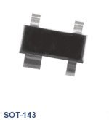
Maxim MAX6803
Pricing information:
  Maxim: Submit Quote

